Slide 1
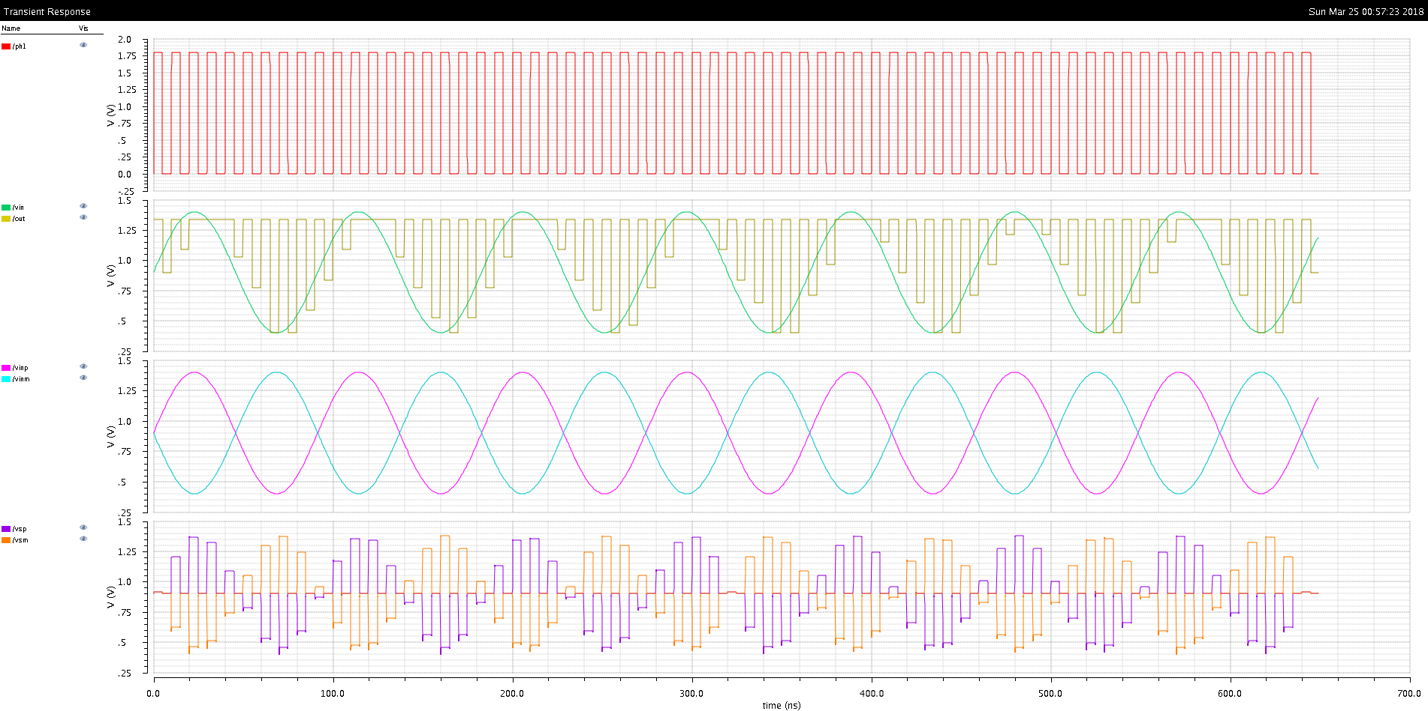
Ph1 Clk
In
Out
Vin+
Vin-
Vs+
Vs-

